Slide 1
Example: Echonet Washing Machine
Andreas Sayegh, Deutsche Telekom
Intended for: SHTF
Dec 9, 2014

Slide 2
Purpose of this contribution
Show another example to use the SDT

Slide 3
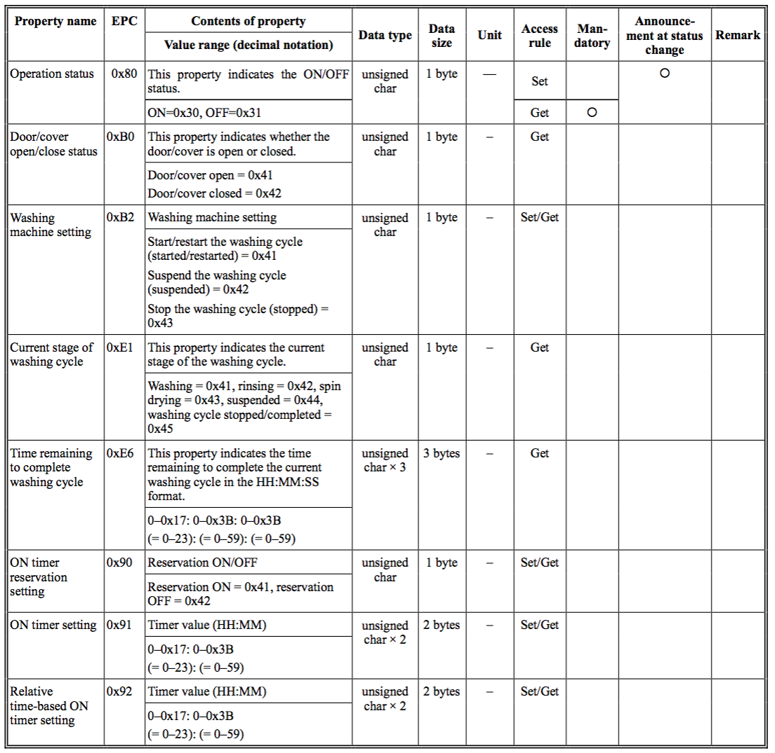
Echonet Washing Machine Source: http://www.echonet.gr.jp/english/spec/pdf_spec_app_e_e/SpecAppendixE_e.pdf

Slide 4
Translation to SDT
Document
<Domain name=“jp.gr.echonet”>
<ModuleClass name=”WashingMachine">
<Data>
<DataPoint name=“operationStatus” type=“boolean” writable=“true” />
<DataPoint name=“doorCoverOpenCloseStatus” type=“boolean” />
<DataPoint name=“washingMachineSetting” type=“integer” writable=“true” />
<DataPoint name=“currentStageOfWashingCycle” type=“integer” />
<DataPoint name=“timeRemainingToCompleteWashingCycle” type=“time” />
<DataPoint name=“onTimerReservationSetting” type=“boolean” writable=“true” />
<DataPoint name=“onTimerSetting” type=“time” writable=“true” />
<DataPoint name=“relativeOnTimeBasedTimerSetting” type=“time” writable=“true” />
</Data>
</ModuleClass>
</Domain>

Slide 5
Requested action
None

Slide 6
Thank You! Andreas.sayegh@telekom.de

